Slide 1
Chapter 9
How to analyze time-series data

Slide 2
Objectives
Applied
Generate date ranges at different time intervals.
Reindex a DataFrame with a generated date range.
Downsample data to a less frequent interval.
Create and plot rolling windows.
Knowledge
Explain how reindexing time-series data can improve plots, but also how it can lead to missing values in the data.
Describe how to apply a function to fix missing values in data that’s indexed by dates.
Distinguish between downsampling and upsampling.
Explain the use of the label and closed parameters in the resample() method.

Slide 3
Objectives (continued)
Explain how downsampling can improve plots.
Describe the use of running totals.

Slide 4
The date_range() method
Method | Description
date_range(params) | Generates a list of datetime periods and returns a DatetimeIndex that contains them.
Parameters of the date_range() method
Parameter | Description
start | The start of the generated datetime values.
end | The end of the generated datetime values.
freq | The frequency of the generated datetime values.

Slide 5
Some of the aliases for the freq parameter
Alias | Frequency | Alias | Frequency
B | business day | Q | quarter end
D | calendar day | QS | quarter start
W | weekly | Y | year end
M | month end | YS | year start
SM | semi-month end (15th and last day) | H | hourly
MS | month start | T | minutely
SMS | semi-month start (1st and 15th) | S | secondly

Slide 6
How to generate a DatetimeIndex for the first date of each month
pd.date_range('01/01/2020', '12/31/2020', freq='MS')
======================================================================
DatetimeIndex(['2020-01-01', '2020-02-01', '2020-03-01', '2020-04-01',
'2020-05-01', '2020-06-01', '2020-07-01', '2020-08-01',
'2020-09-01', '2020-10-01', '2020-11-01', '2020-12-01'],
dtype='datetime64[ns]', freq='MS')
How to generate a DatetimeIndex for all Monday-Friday dates
pd.date_range('01/01/2020', '01/31/2020', freq='B')
How to generate a DatetimeIndex for all Mondays
pd.date_range('12/01/2020', '12/31/2020', freq='W-MON')
How to generate a DatetimeIndex for every 12 hours
pd.date_range('01/01/2020', '01/31/2020', freq='12H')

Slide 7
The reindex() method
Method | Description
reindex(params) | Replaces the old index with a new one, keeping the rows where the indexes match.
Parameters of the reindex() method
Parameter | Description
index | The new index.
fill_value | The value that’s used for missing values in the index. The default is NaN.
method | A method that determines how gaps in an index with increasing or decreasing values are filled.

Slide 8
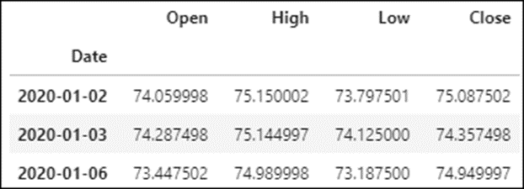
The stock market data
stockData.set_index('Date', inplace=True)
stockData.head(3)

Slide 9
How to generate a DataTimeIndex for all Fridays in a year
fridays = pd.date_range('01/01/2020', '12/31/2020', freq='W-FRI')
fridays
=================================================================
DatetimeIndex(['2020-01-03', '2020-01-10', '2020-01-17', '2020-01-24',
'2020-01-31', '2020-02-07', '2020-02-14', '2020-02-21',
...
'2020-11-06', '2020-11-13', '2020-11-20', '2020-11-27',
'2020-12-04', '2020-12-11', '2020-12-18', '2020-12-25'],
dtype='datetime64[ns]', freq='W-FRI')

Slide 10
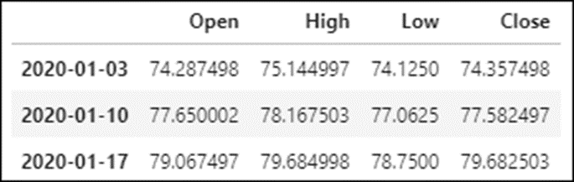
How to reindex the data
stockData.reindex(fridays).head(3)

Slide 11
How to generate all the semi-month dates in a year
semiMonths = pd.date_range('01/01/2020', '12/31/2020', freq='SMS')
semiMonths
==================================================================
DatetimeIndex(['2020-01-01', '2020-01-15', '2020-02-01', '2020-02-15',
'2020-03-01', '2020-03-15', '2020-04-01', '2020-04-15',
'2020-05-01', '2020-05-15', '2020-06-01', '2020-06-15',
'2020-07-01', '2020-07-15', '2020-08-01', '2020-08-15',
'2020-09-01', '2020-09-15', '2020-10-01', '2020-10-15',
'2020-11-01', '2020-11-15', '2020-12-01', '2020-12-15'],
dtype='datetime64[ns]', freq='SMS-15')

Slide 12
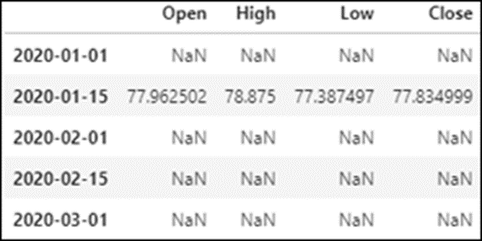
How to reindex the stock data with the semi-month index
stockData.reindex(semiMonths).head()

Slide 13
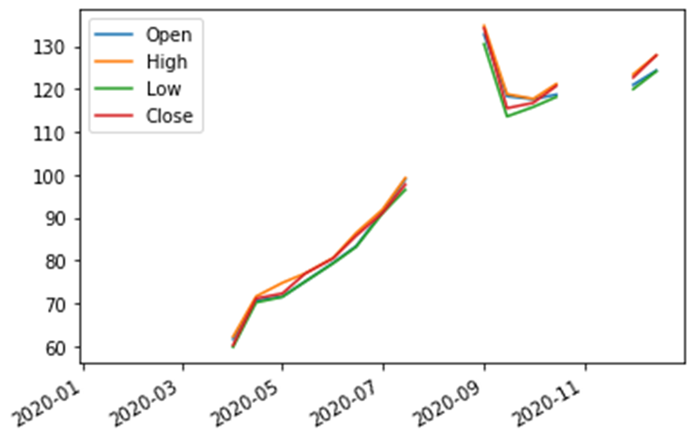
How to plot the semi-month data
stockData.reindex(semiMonths).plot()

Slide 14
A user-defined function that converts weekend dates to weekdays
import datetime as dt
def adjustDate(date):
if date.weekday() < 5:
return date
elif date.weekday() == 5:
return date - dt.timedelta(days=1)
else:
return date + dt.timedelta(days=1)

Slide 15
How to apply the user-defined function
semiMonths = pd.date_range('01/01/2020', '12/31/2020', freq='SMS')
semiMonthsAdjusted = semiMonths.to_series().apply(adjustDate)
semiMonthsAdjusted.head()
=============================================================
2020-01-01 2020-01-01
2020-01-15 2020-01-15
2020-02-01 2020-01-31
2020-02-15 2020-02-14
2020-03-01 2020-03-02

Slide 16
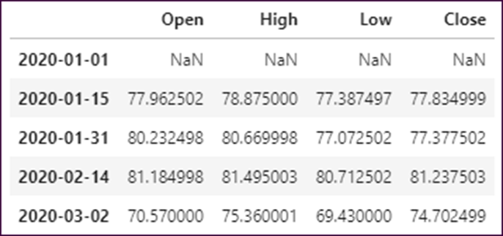
How to reindex on the adjusted dates
stockData.reindex(semiMonthsAdjusted).head()

Slide 17
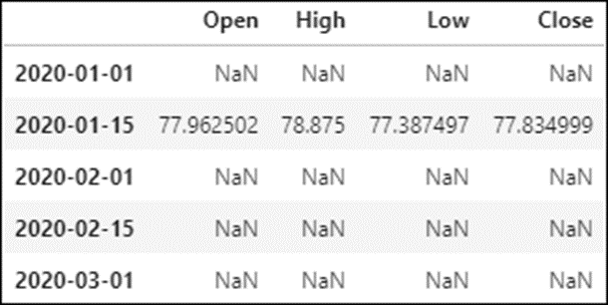
The semiMonths data before adjustment
stockData.reindex(semiMonths).head()

Slide 18
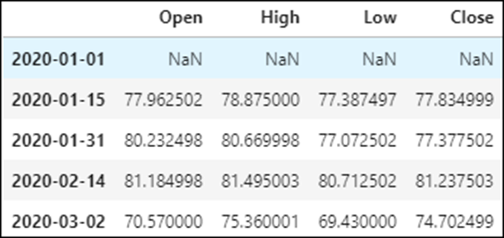
The semiMonthsAdjusted data
stockData.reindex(semiMonthsAdjusted).head()

Slide 19
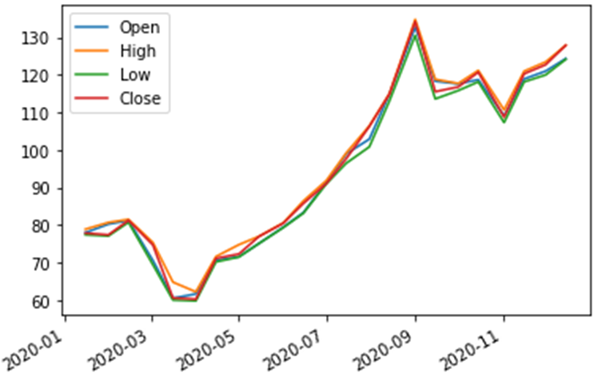
The plotted semiMonthsAdjusted data
stockData.reindex(semiMonthsAdjusted).plot()

Slide 20
The resample() method
Method | Description
resample(params) | Converts time-series data from one frequency to another.
One parameter of the resample() method
Parameter | Description
rule | The new frequency. Uses the same values as the freq parameter in figure 9-1.

Slide 21
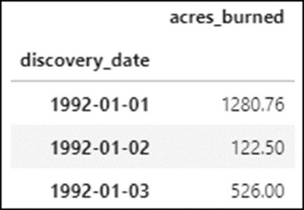
The acresBurned data
acresBurned.head(3)

Slide 22
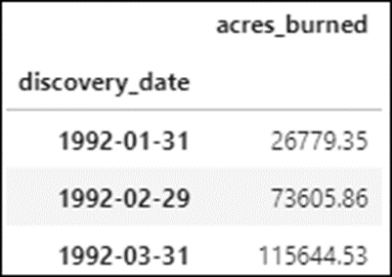
How to downsample the data
acresBurned.resample(rule='M').sum().head(3)

Slide 23
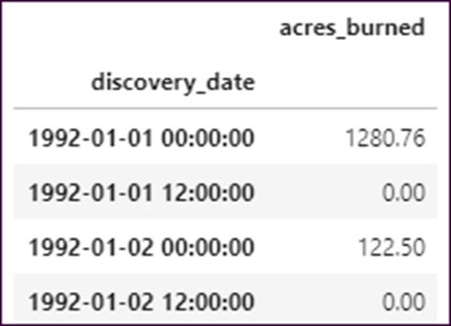
How to upsample the data
acresBurned.resample(rule='12H').sum().head(4)

Slide 24
The label and closed parameters of the resample() method
Parameter | Description
label | Which bin edge will be used as the label: right or left. The default depends on the rule parameter.
closed | Which bin edge will be closed: right or left. The closed edge is included in the aggregated data.

Slide 25
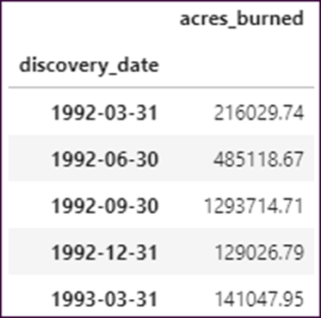
How to downsample with right labels and a closed right edge
acresBurned.resample(rule='Q', label='right',
closed='right').sum().head()

Slide 26
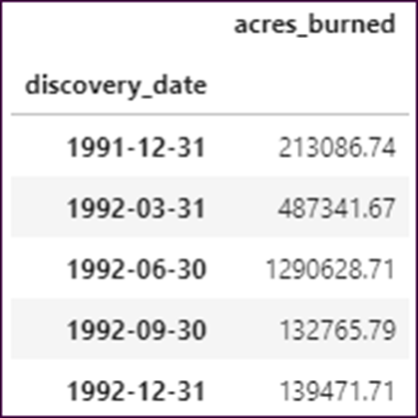
How to downsample with left labels and a closed left edge
acresBurned.resample(rule='Q', label='left',
closed='left').sum().head()

Slide 27
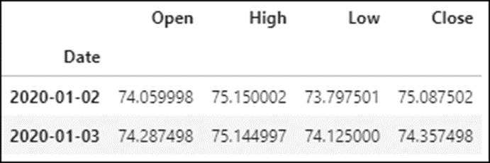
The data before downsampling
stockData.head(2)

Slide 28
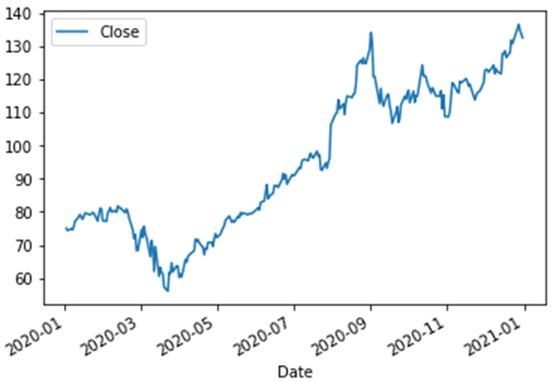
A line plot before downsampling
stockData.plot(y='Close')

Slide 29
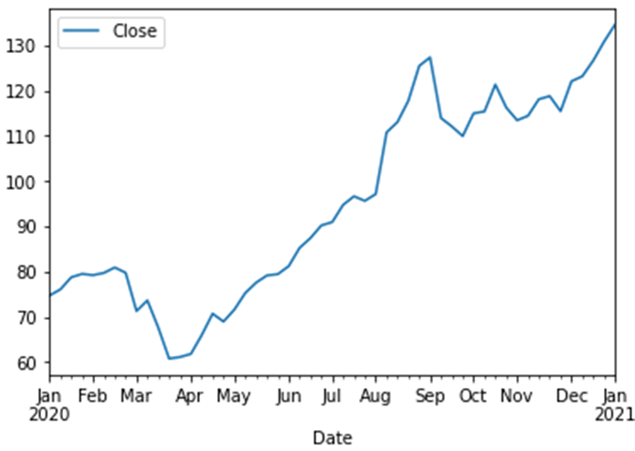
A line plot after downsampling
stockData.resample(rule='W').mean().plot(y='Close')

Slide 30
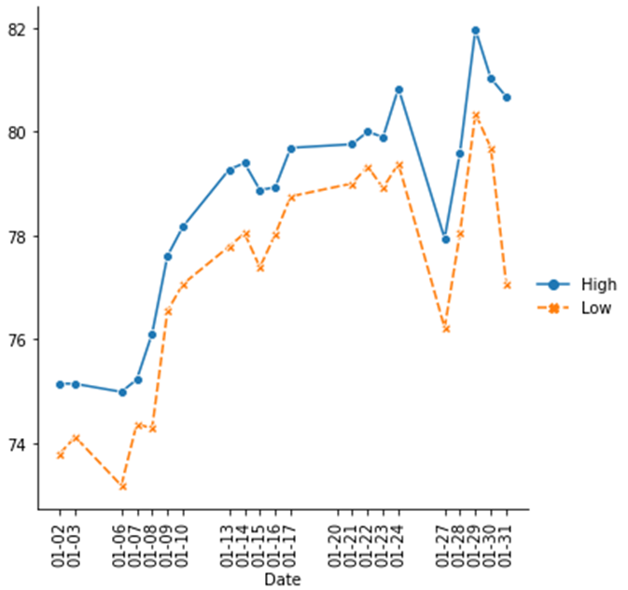
The highs and lows for the stock data without rolling windows

Slide 31
The highs and lows for the stock data with rolling windows

Slide 32
The rolling() method
Method | Description
rolling(params) | Creates a moving window (bin) that can be used for performing aggregations.
Parameters of the rolling() method
Parameter | Description
window | The size in number of rows or columns of the window.
min_periods | The minimum number of consecutive values required for a window value. The default is the size of the window.

Slide 33
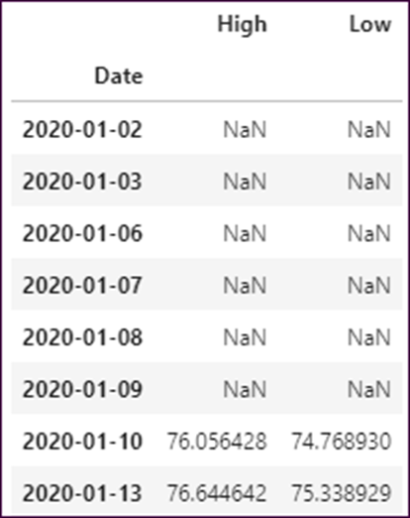
How to use the rolling() method
df = stockData[['High','Low']]. \
query('Date <= "01/31/2020"').rolling(window=7).mean()
df.head(8)

Slide 34
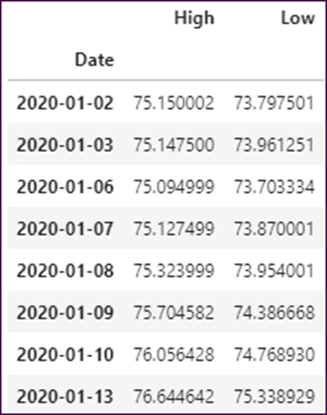
Another example of the rolling() method
df = stockData[['High','Low']]. \
query('Date <= "01/31/2020"').rolling(window=7, min_periods=1).mean()
df.head(8)

Slide 35
How to plot rolling windows
df = stockData[['High','Low']]. \
query('Date <= "01/31/2020"').rolling(window=7).mean()
g = sns.relplot(data=df, kind='line', markers=True)
for ax in g.axes.flat:
ax.tick_params('x', labelrotation=90)
ax.set_xticks(pd.date_range(start='01/10/2020', end='01/31/2020',
freq='B'))
ax.set_xticklabels(pd.date_range(start='01/10/2020',
end='01/31/2020', freq='B').strftime('%Y-%m-%d'))

Slide 36
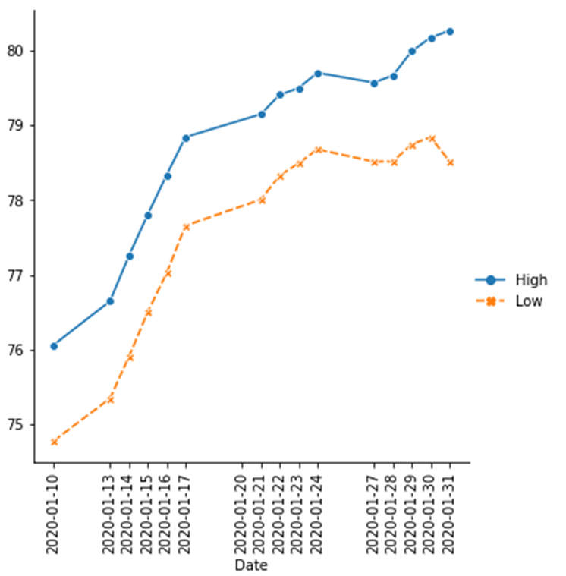
How to plot rolling windows (continued)

Slide 37
The expanding() method
Method | Description
expanding(params) | Creates a running aggregation for the DataFrame.
The parameter of the expanding() method
Parameter | Description
min_periods | Minimum number of observations required to have a value.

Slide 38
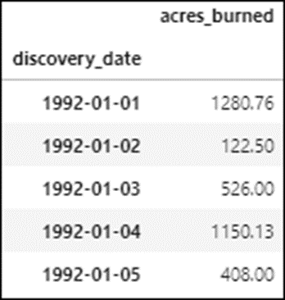
The acresBurned DataFrame
acresBurned.head()

Slide 39
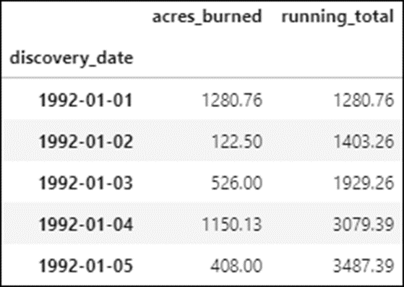
How to use the expanding() method
acresBurned['running_total'] = acresBurned.expanding().sum()
acresBurned.head()

Slide 40
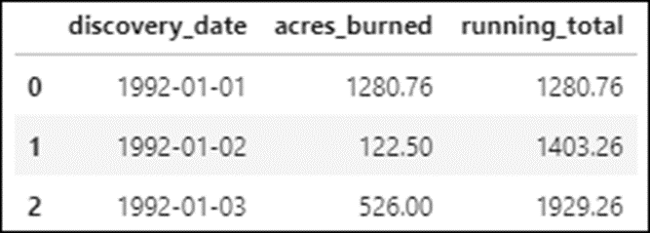
The acresBurned data for the first 10 days of 1992
acresBurned.reset_index(inplace=True)
acresBurned.head(3)

Slide 41
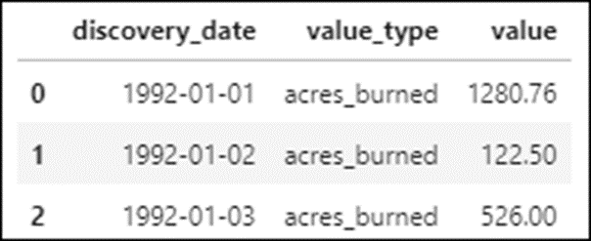
The prepared data
acresMelted = pd.melt(acresBurned, id_vars='discovery_date',
value_vars=['acres_burned','running_total'],
var_name='value_type')
acresMelted.head(3)

Slide 42
How to plot the running totals
g = sns.catplot(data=acresMelted, kind='bar',
x='discovery_date', y='value', hue='value_type', aspect=1.5)
for ax in g.axes.flat:
ax.tick_params('x', labelrotation=90)
ax.set_xticklabels(
acresMelted.discovery_date.drop_duplicates().astype(str))

Slide 43
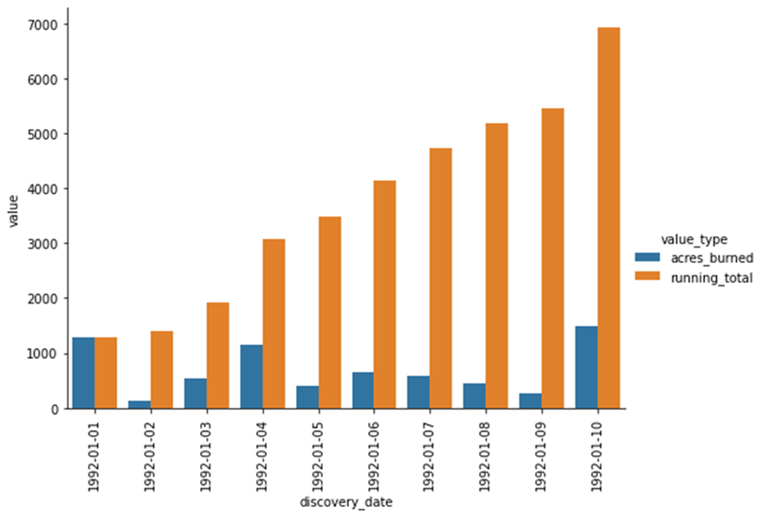
How to plot the running totals (continued)

